Slide 1
Presentation Skills Pre-Lecture Questions
What experiences have you had presenting/performing to an audience? Have you attended conferences where you have presented something to an audience? Details…
Have you ever experienced performance anxiety or stage fright? In what context? What were the symptoms? How did you overcome it?

Slide 2
How to Keep your Audience Interested: Scientific Communication and Conference Skills
Faculty of Nuclear Physics and Physical Engineering
Languages Department
Darren Copeland MSc

Slide 3
Motivation
Specialists help elucidate the world

Slide 4
Context
Science/Maths have been performative from the very beginning
A desire to see reason champion belief
Best academic work has the ability to stretch
The best academics work to engage public scholarship
The need for imagination

Slide 9
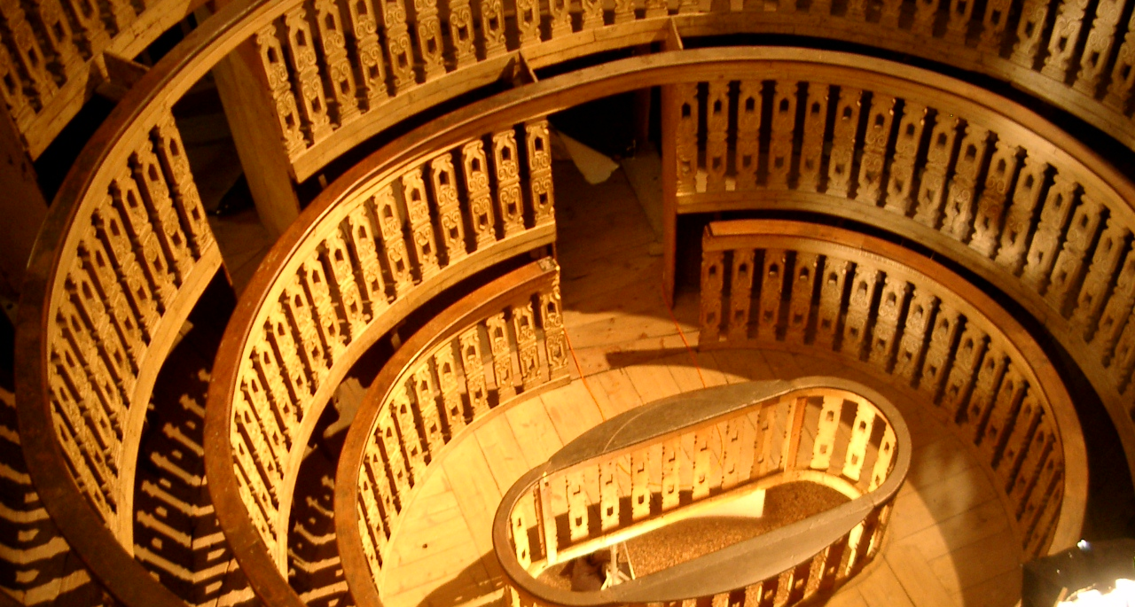

Slide 20
Crossing the Rubicon

Slide 21
Audience Attention
Introduction
Conclusion
Time

Slide 23
The Voice
English- pronunciation- not the easiest!
She stood on the balcony
Mimicking him hiccupping
And inimitably beckoning him in

Slide 24
Small Stokes Shift

Slide 25
Some theories believe there to be things out there.

Slide 28
How you feel going into a presentation
directly impacts your vocal control
and
your non-verbal communication

Slide 29
How you deliver directly impacts your audience and yourself
Confident body language
Confident vocal delivery
A confluence of minds- co-opting the urge to fight or fly
Leads to a clear through-line of thought

Slide 30
OK! But what about the content?
Take your audience with you!

Slide 31
Benefit: what’s in it for me?
Giving presentations in English is a challenge
A natural-born public speaker?
Naturally introverts and extroverts
Assumptions- must be challenged!
A few helpful tips on public speaking
Tried and tested approaches that help facilitate clear communication.

Slide 32
Darren Copeland Who is he?
More than 30 years in Education and Performance
Taught in Four Different Continents- lots of different countries
All Levels of Education
Graduates include successful actors, writers, politicians, journalists, lawyers, teachers, even rock stars
And now ….Scientists and Mathematicians

Slide 33
Where are you taking us Darren?
Route map: directions!
Opening
Main Body: Smooth Structure and Transitions
Visual Aids- graphics and visual data
Closing
Confidence-Building: tips and tricks
The Takeaway

Slide 34
And…This was the Opening
Attention
Benefit
Credibility
Direction

Slide 35
A. B. C. D.
Attention
Benefit
Credibility
Direction

Slide 37
Audience Attention
Introduction
Conclusion
Time

Slide 40
Images and Speech combine to fix sense
Audience are auditors- listeners constructing mental images
Science and Mathematics often conceptual and abstract
Good communicators help make the abstract tangible
Audience imagines the world described
Radio has the best pictures!

Slide 41
The Great Explainer
Richard Feynman
1918-1988

Slide 43
Main Body Smooth Structure Signposting
Discourse markers
Earlier we saw… This leads us on to… Firstly… As you’ll recall… Later we’ll see… You’ll remember we looked at… This brings us on to… By the end of this talk you will…
Rhetorical Questions
The question is, why? The problem is, where can we go for a solution? Why, you may ask, at 150 degrees Celsius?

Slide 44
Emphasis through discourse marking
Additive: and, in addition, furthermore, also.
Contrastive: but, however, on the other hand, although.
Sequential: first, then, next, finally.
Causal: because, therefore, so, as a result.
Conclusive: in conclusion, to sum up, in summary.

Slide 45
The smallest details often have the biggest consequences
"A well regulated militia being necessary to the security of a free state, the right of the people to keep and bear arms shall not be infringed."

Slide 46
Visual Aids- graphics and visual data Science and Mathematics
Complex data- clearly visible
Images with optical enhancements
Figures and Graphs
Equations and Formulae
Research Results and Discussion
Framed, explained and communicated effectively in assimilable increments

Slide 48
Speech fixes the meaning of an image
An image clarifies the meaning of speech

Slide 52
What should be in a conclusion?
SWEAT
Summary
Words of Wisdom
Emotional Appeal
Action: a call to arms!
T…. ?

Slide 53
Where have you taken us Darren?
Opening
Route map: directions!
Main Body: Smooth Structure and Transitions
Visual Aids- graphics and visual data
Closing

Slide 54
The Takeaway
Know your material
Do your Best
Remember the words of John Lydgate (made famous by
President Abraham Lincoln):
You can please some of the people all of the time,
you can please all of the people some of the time,
but you can’t please all of the people all of the time

Slide 55
In other words, say to yourself- I’m doing my best and if you don’t like it,

Slide 56
Acknowledgments
Inspired by
and dedicated to
the staff and students of CTU

